Slide 1
Docker for Databases
Scott Sauber
He/Him
Director of Engineering
Lean TECHniques Inc.

Slide 2
Agenda
What is Docker?
Why Docker?
How does it work?
Demo
Docker + Databases = 😍

Slide 3
Goals
Understand what Docker is
Understand when to use Docker and when not to with your DB

Slide 4


Scott
Sauber
He/Him
Director of Engineering
Friend of Redgate
Co-organizer of Iowa .NET User Group
DevOps Fanatic
Pipelines for dozens of databases
Lean TECHniques Inc.
@scottsauber
scottsauber.com

Slide 5
What is Docker?
Tools to allow you to run applications in an isolated environment called containers (agnostic to Docker)
Backed by Docker Inc.
Synonymous with containers, like Kleenex

Slide 6
What is an image?
Immutable file with instructions for how to create a container
Made up of layers
Starts with an OS
Installs any applications

Slide 7
What is a container?
Runnable instance of an image
Like a self-contained VM
Isolated from other containers

Slide 8
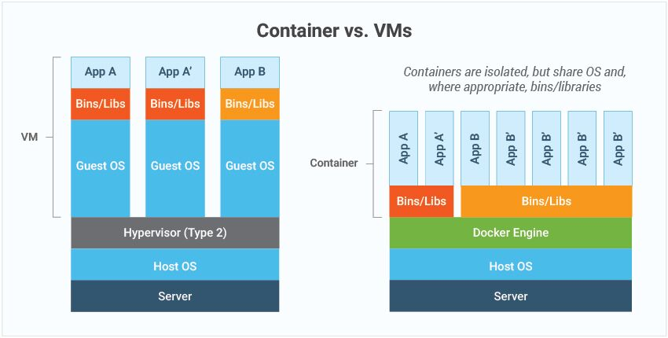
Containers vs VMs

Slide 9
Why Containers?
“Works on my machine”
Isolated
Repeatable
Fast to spin up
Notes:
Avoid installing applications on your machine

Slide 10
Container Registry
Sharing images
Images tagged with versions (i.e. MSSQL 2022, 2019, specific CUs, etc)
Docker Hub is public example

Slide 11
Demo
Notes:
Docker Hub
docker pull
docker image ls
docker run
docker run -p
docker container ls
docker container ls –a
Docker run again
docker container ls
Docker stop
Docker-compose.yml

Slide 12
DevOps Challenges With Databases
Development
CI
Isolated from other team members
Re-applying all migrations
Version matching

Slide 13
Which of these does Docker solve?
Development
CI
Isolated from other team members
Re-applying all migrations
Version matching

Slide 14
Which of these does Docker solve?
Development ✅
CI ✅
Isolated from other team members ✅
Re-applying all migrations✅
Version matching✅

Slide 15
When do I NOT Dockerize my DB?
For non-local/CI environments
Definitely not for Production
Prefer PaaS over IaaS

Slide 16
Docker Adoption Progression
Start using Docker with local dev
Start using Docker in CI for tests
Start publishing Docker images with your schema
Start including data sets with schema

Slide 17
Takeaways
Overview of what Docker is
Where Docker fits (Local + CI) and where it doesn’t (Production)

Slide 18
Message for the end of the presentation goes here
Scott Sauber
ssauber@leantechniques.com
@scottsauber

